Slide 1

INTRO TO LINUX

Slide 2
UNIX
UNIX is a family of multitasking, multi-user computer operating systems that derive from the original AT&T Unix, whose development started in 1969 at the Bell Labs research center by Ken Thompson, Dennis Ritchie, and others.

Slide 3
GNU
Founded by Richard Stallman in 1983 with the goal of creating a completely free Unix-like operating system.
GNU General Public License (GPL): Ensures that software remains free and open.
GNU Tools: Includes critical components like the GNU Compiler Collection (GCC) and the GNU Bash shell.
( GNU's Not UNIX )

Slide 4
LINUX
Linux is a generic name for a family of open-source Unix-like operating systems based on the Linux kernel
Linux kernel was created by Linus Torvalds in 1991 as a free and open-source alternative to UNIX.

Slide 5












DISTROS
Aka Distributions

Slide 6
Terminal
Wrapper program which runs a shell.
It is a software application that provides a text-based interface for interacting with the operating system.
Examples:
- GNOME Terminal
- KDE Konsole
- Kitty
- Alacritty

Slide 7
Shell
A shell is a program that acts as an interface between the user and the operating system.
It interprets commands entered by the user and executes them.
It can also be used for scripting to automate tasks.
Eg : sh, bash, zsh, fish

Slide 8

Bash
Bourne-Again SHell
Released in 1989 as a free software alternative to Bourne Shell (sh)
Default login shell for many Linux distributions and earlier versions of macOS.

Slide 9
Shell Scripting
A bash script is a series of commands written in a file which are read and executed by the bash program line by line.
Convention: ends with .sh (Not mandatory)
Scripts start with a shebang followed by the absolute path to the shell.
#! /bin/bash

Slide 10
Shell Scripting
Give execution rights / permission
chmod u+x yourfile.sh
Execute:
./yourfile.sh

Slide 11
Package Managers
A package manager is a tool that allows users to install, remove, upgrade, configure and manage software packages on an operating system.
A Package can be a GUI application, command line tool or a software library
Eg : apt, dnf, pacman
To install a package in Ubuntu :
sudo apt install your-package

Slide 12
Some Useful Commands

Slide 13
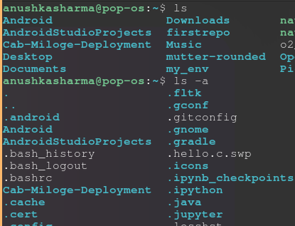
Command: ls
The ls command in Linux is used to list the contents of a directory, showing files and subdirectories.
some important flags used with the ls command:
-l: Displays a detailed list, including file permissions, number of links, owner, group, size, and modification date.
-a: Lists all files, including hidden files (those starting with a dot).
-h: Shows file sizes in a human-readable format (e.g., KB, MB).

Slide 14
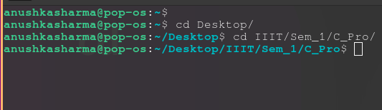
Command: cd
The cd (change directory) command in Linux is used to navigate between directories in the filesystem.
Example:
cd folder
cd ..
cd
cd ~

Slide 15
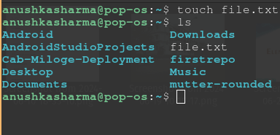

Command: touch
The touch command in Linux is primarily used to create an empty file or update the timestamp of an existing file.
some important flags used with the touch command:
-a: Updates only the access time of the file.
-m: Updates only the modification time of the file.
-c: Does not create the file if it does not exist; only updates timestamps if the file is present.

Slide 16
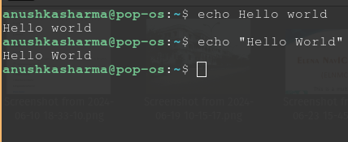
Command: echo
The echo command in Linux is used to display a line of text or string to the terminal.
some important flags used with the echo command:
-n: Prevents the trailing newline, so the output stays on the same line as the next command.
-e: Enables interpretation of backslash-escaped characters like \n for a new line, \t for a tab, and \\ for a backslash.

Slide 17
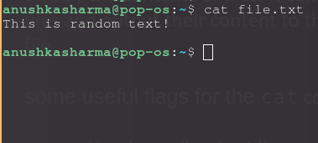
Command: cat
The cat command in Linux is used to concatenate and display the contents of files. It can read one or multiple files and output their content to the terminal or another file.
some useful flags for the cat command:
-n: Numbers all output lines.
-b: Numbers only non-blank output lines.
-s: Suppresses repeated empty lines, reducing multiple blank lines to a single blank line.

Slide 18
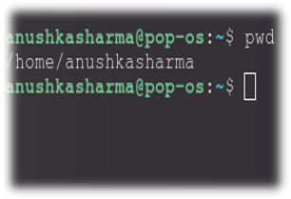
Command: pwd
The pwd (print working directory) command in Linux displays the full path of the current working directory.

Slide 19
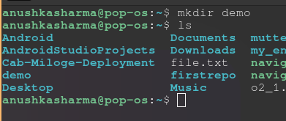

Command: mkdir
The mkdir (make directory) command in Linux is used to create new directories. By providing a directory name as an argument, you can create a single directory.
some commonly used flags with the mkdir command:
-p: Creates parent directories as needed. For example, mkdir -p /path/to/new/dir will create the entire directory structure if it doesn’t already exist.

Slide 20
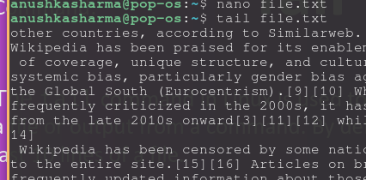
Command: tail
The tail command in Linux is used to display the end of a file or output from a command. By default, it shows the last 10 lines of a file.
some useful flags for the tail command:
-n [NUM]: Shows the last [NUM] lines of the file or output. For example, tail -n 20 file.txt shows the last 20 lines.

Slide 21
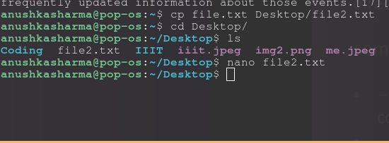
Command: cp
The cp command in Linux is used to copy files and directories from one location to another.
some commonly used flags with the cp command:
-r or -R: Recursively copies directories and their contents. This is necessary when copying directories.
-i: Prompts for confirmation before overwriting files.

Slide 22
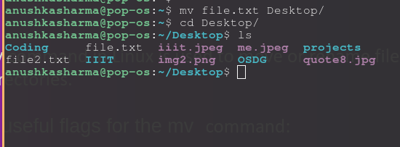
Command: mv
The mv command in Linux is used to move or rename files and directories.
some useful flags for the mv command:
-i: Prompts for confirmation before overwriting an existing file at the destination.
-f: Forces the move without prompting for confirmation, even if it overwrites existing files.
-u: Moves the file only if the source file is newer than the destination file, or if the destination file does not exist.

Slide 23
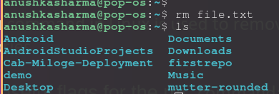
Command: rm
The rm command in Linux is used to remove files or directories.
some useful flags for the rm command:
-r or -R: Recursively removes directories and their contents.
-i: Prompts for confirmation before each file or directory is removed, adding a layer of safety to the deletion process.
-f: Forces the removal of files or directories without prompting for confirmation

Slide 24
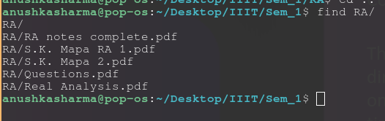
Command: find
The find command in Linux is used to search for files and directories within a directory hierarchy. It can search based on various criteria such as name, type, size, modification time, and more.
Some commonly used flags with the find command:
-name [pattern]: Searches for files or directories that match a specific name or pattern
-type [f/d]: Specifies the type of file to search for: f for regular files and d for directories
Etc.

Slide 25
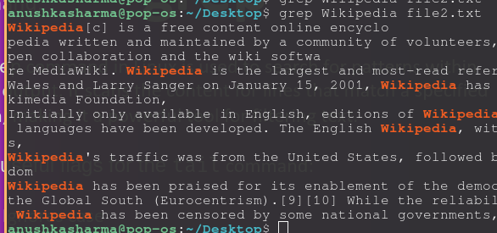
Command: grep
The grep command in Linux is used to search for patterns within files or output. It scans the content for lines that match a specified pattern, making it a powerful tool for filtering text.
Some useful flags for the tail command:
-i: Ignores case
-r or -R: Recursively searches through directories, allowing you to find matches in all files within a directory tree.
-c: Outputs the count of matching lines instead of the lines themselves
-l : list the names of files that contain the specified pattern.

Slide 26
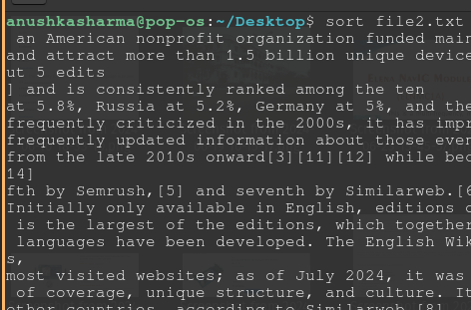
Command: sort
The sort command in Linux is used to sort lines of text files
Some commonly used flags with the find command:
-n: Sorts lines numerically.
-r: Reverses the order of the sort
-f: Ignores case when sorting
-u: Removes duplicate lines from the output

Slide 27
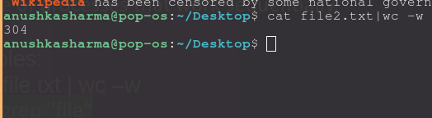
piping
A pipe (|) is used to connect the output of one command directly into the input of another command. This allows you to chain multiple commands together, creating a pipeline of processes that work sequentially.
Examples:
cat file.txt | wc –w
ls | grep "file“

Slide 28
Redirection
Redirection is the act of dictating where the inputs or outputs of your commands go.
Input Redirection :
./a.out < input.txt
Output Redirection :
./a.out > output.txt

Slide 29
Command: man
The "man" command, short for manual, is a powerful tool in the Linux operating system that allows users to access detailed information about various commands, utilities, and system calls.
Examples:
man scanf
man 3 printf
man qsort
man cat

Slide 30
Hyperlinks
https://github.com/anushkasharma2005/Intro-to-Bash-Linux/tree/main
https://cmdchallenge.com/
https://devhints.io/bash
https://github.com/RehanSaeed/Bash-Cheat-Sheet
https://youtube.com/watch?v=m20pNf-ZieUpNf-ZieU

Slide 31
Let's Practice!

Slide 32
Thank You!

Slide 33
UNIX
UNIX is a family of multitasking, multi-user computer operating systems that derive from the original AT&T Unix, whose development started in 1969 at the Bell Labs research center by Ken Thompson, Dennis Ritchie, and others.

Slide 34
GNU ( GNU's Not UNIX )
Founded by Richard Stallman in 1983 with the goal of creating a completely free Unix-like operating system.
GNU General Public License (GPL): Ensures that software remains free and open.
GNU Tools: Includes critical components like the GNU Compiler Collection (GCC) and the GNU Bash shell.

Slide 35
LINUX
Linux is a generic name for a family of open-source Unix-like operating systems based on the Linux kernel
Linux kernel was created by Linus Torvalds in 1991 as a free and open-source alternative to UNIX.

Slide 36

DISTROS
Aka Distributions
Ubuntu
Debian
Fedora
Arch
PopOS
And many more....

Slide 37
Package Managers
A package manager is a tool that allows users to install, remove, upgrade, configure and manage software packages on an operating system.
A Package can be a GUI application, command line tool or a software library
Eg : apt, dnf, pacman
To install a package in Ubuntu :
sudo apt install your-package

Slide 38
Terminal
Wrapper program which runs a shell
GNOME Terminal
KDE Konsole
Kitty
Alacritty

Slide 39
shell
A shell is a program that acts as an interface between the user and the operating system.
It interprets commands entered by the user and executes them.
It can also be used for scripting to automate tasks.
Eg : sh, bash, zsh, fish

Slide 40
bash
Bourne-Again SHell
Released in 1989 as a free software alternative to Bourne Shell (sh)
Default login shell for many Linux distributions and earlier versions of macOS.

Slide 41
Shell Scripting
A bash script is a series of commands written in a file which are read and executed by the bash program line by line.
Convention: ends with .sh (Not mandatory)
Scripts start with a shebang followed by the absolute path to the shell.
#! /bin/bash

Slide 42
Shell Scripting
Give execution rights / permission
chmod u+x yourfile.sh
Execute:
./yourfile.sh

Slide 43
Hyperlinks
https://cmdchallenge.com/
https://devhints.io/bash
https://github.com/RehanSaeed/Bash-Cheat-Sheet

